Slide 1
Obstacle sense and Voice Control Arduino Robot
➠Nithin U
➠Mohamed jameer N
➠Sharan shakthi G

Slide 2
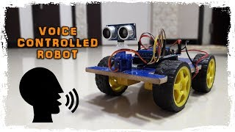
Outcome:

Slide 3
Agenda:
Requirements and Analysis.
Design and Coding.
Operations and Outcome
Pros and Cons.

Slide 4
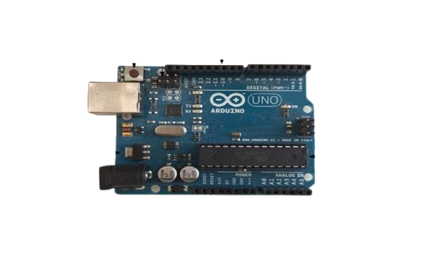
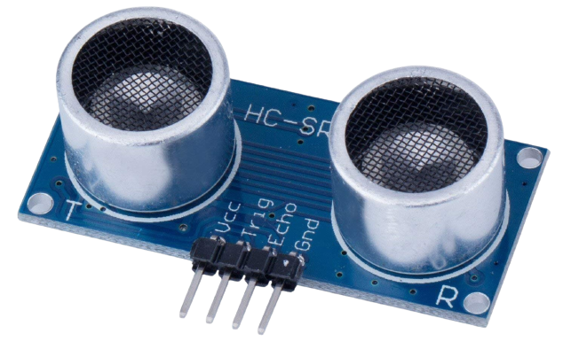
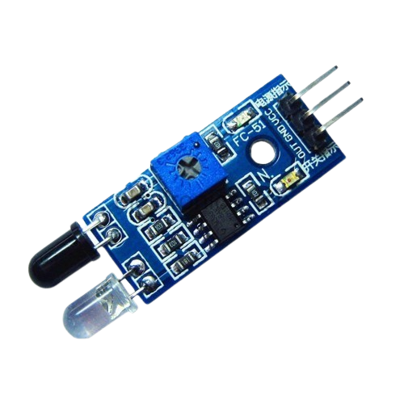
Requirements:
Arduino Uno
L293D Motor Driver
TT Gear Motor and wheels
Rubber Wheels
Ultrasonic Sensor
Proximity IR Sensor

Slide 5
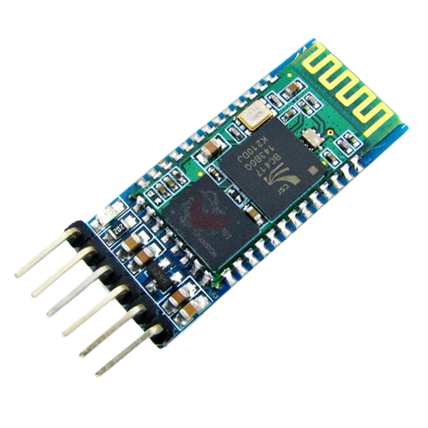
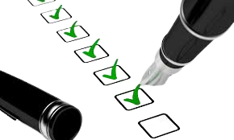
HC05 Bluetooth Module
18650 Battery (3.7V Lithium Battery)
18650 Battery Holder
Acrylic Sheet
DC Switch

Slide 6
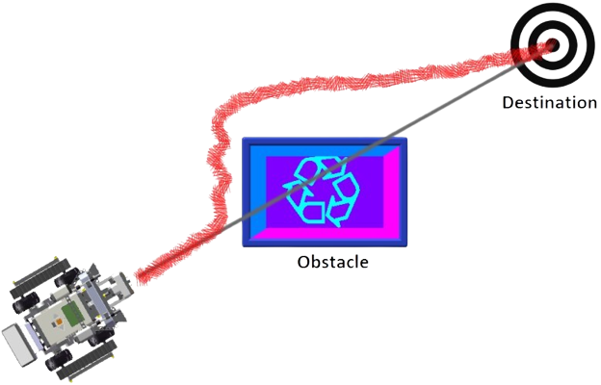
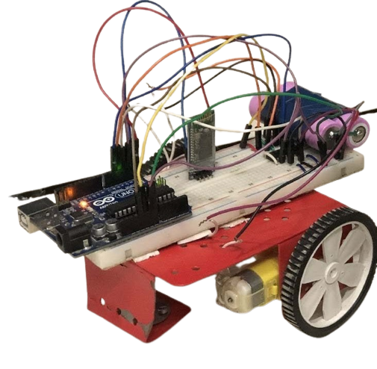
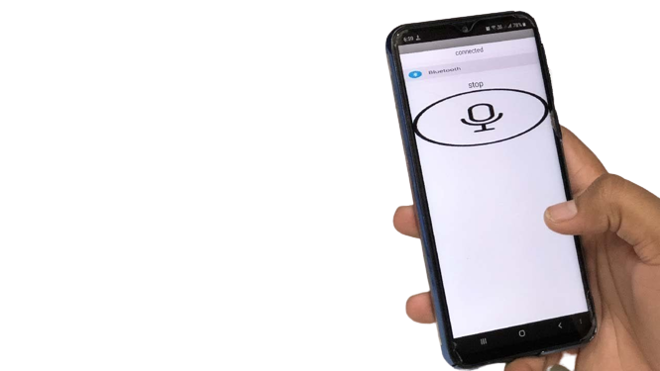
Analysis:
A Sample Arduino Robot to work under Human Voice Command and Need to Sense Obstacle to avoid crash.

Slide 7
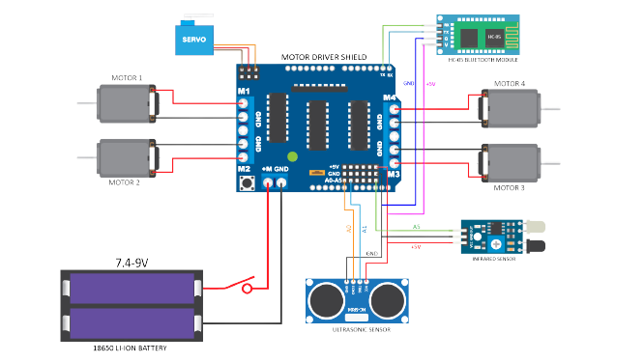
Design:

Slide 8
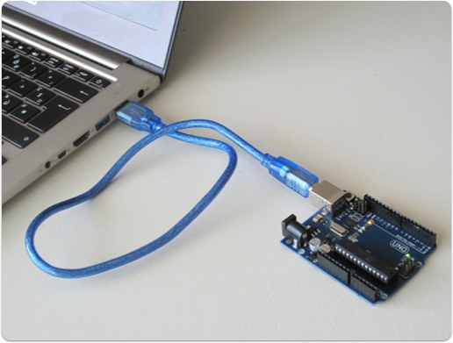
Coding:
We Need to install Arduino Software Program the kit.
Language: C and C++.
Special Libraries Have to install and load to the Kit.
Here We Gonna use Servo , AFMotor and NewPing.

Slide 9
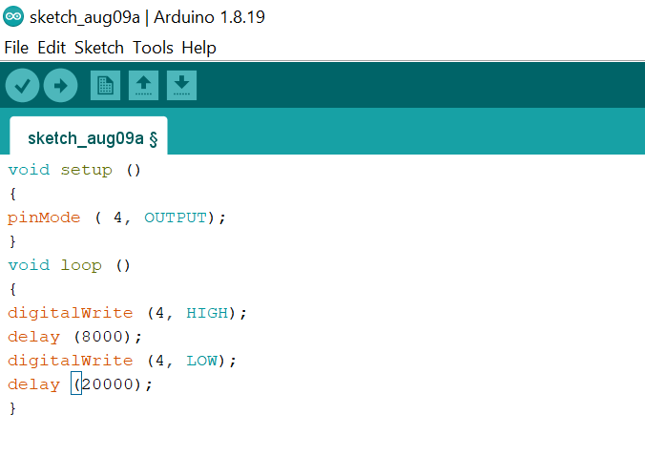
Demo Arduino Code:
Arduino code Consist of Preparation block and execution block.

Slide 10
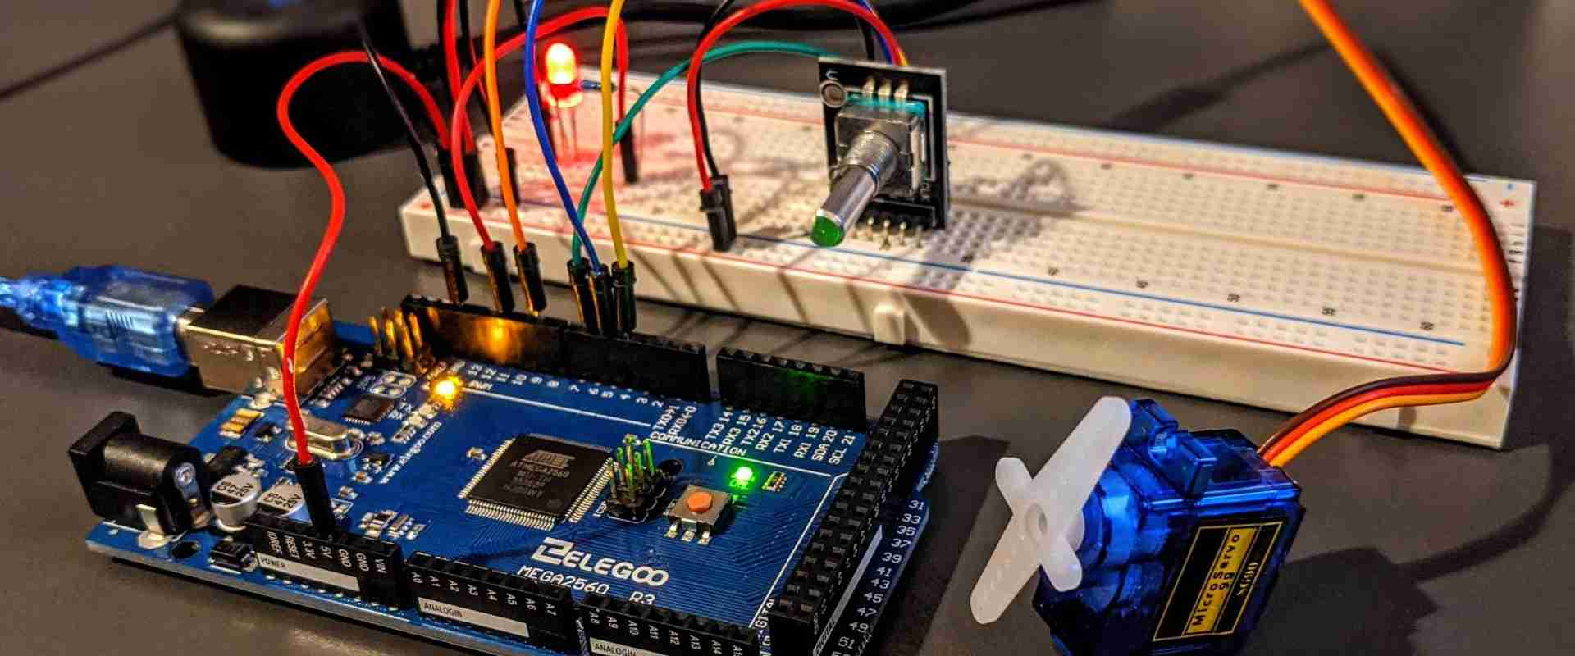
Operations:
Arduino is an open-source electronics platform based on easy-to-use hardware and software. Arduino boards are able to read inputs - light on a sensor, a finger on a button, or a Twitter message - and turn it into an output - activating a motor, turning on an LED, publishing something online.

Slide 11

Outcomes:
Understand the value and importance of learning a coding language with IOT Devices.
Be able to write a simple program in C and C++ with GUN Compiler and execute in projects.
Transform a physical input into a digital input and analyze it.
Understand the function of electronic sensors and components

Slide 12

Pros And cons:
Ready to Use with few Lines Of Code.
Simple and Easy learning of code to instruct a machine.
Great Effort Makes New Projects Over It and products are Reusable.
large user community, free and broad ranges of libraries of codes, relatively low cost components.

Slide 13

Structure Of Arduino is the main disadvantage as it cannot stick for big pcb boards. Suitable for project as small size.
Many people has hesitate to provide cost for this project by thinking as low cost to get creative outcome.
Report:
₹ This project Takes 2,680 Rupees for requirements .
⌛ Need Time Duration of 2 Months

Slide 14
Thank You

